Slide 1
Cloud Computing & Client-Server Architecture
Cloud computing is a model for enabling on-demand network access to a shared pool of configurable computing resources (e.g., networks, servers, storage) that can be rapidly provisioned.
It relies heavily on client-server architecture, where clients (your laptop, phone) request services or resources, and servers (powerful remote machines) fulfill those requests. In the cloud, these servers are often virtualized and located in massive data centers.

Slide 2
Cloud Computing & Client-Server Architecture
Example: Google Drive. Your browser (client) sends a request to save a file. Google's servers process this, store the file across multiple systems, and confirm the save. The user never interacts with the physical server, only the service.
Importance/Relevance: This architecture is the foundation of modern internet services (email, streaming, social media). Understanding it is critical for designing scalable, cost-effective systems. It moves computing power from the user's device to the network, enabling access from anywhere.

Slide 3
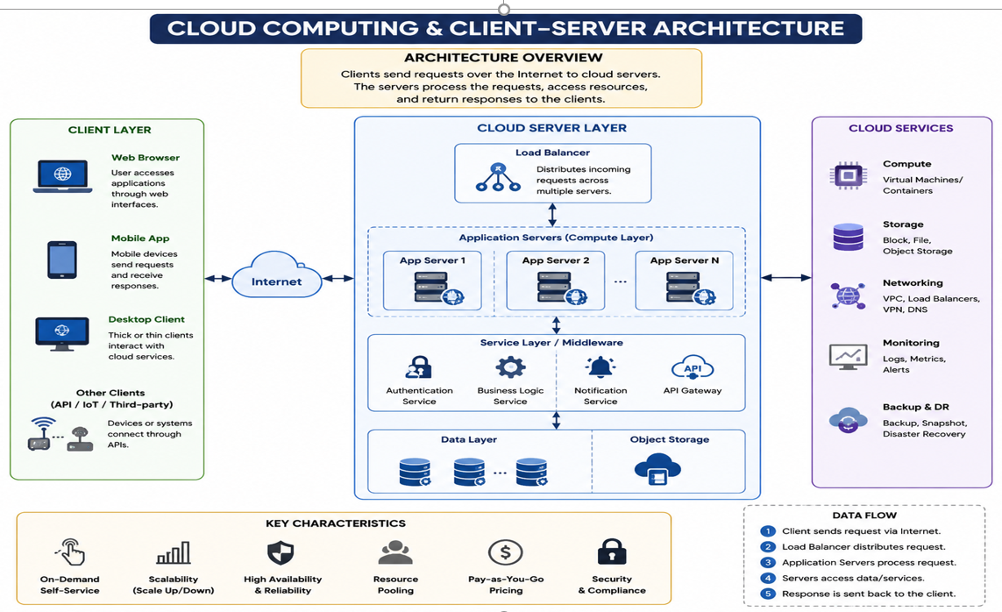
Cloud Computing & Client-Server Architecture

Slide 4
Concurrency, Race Conditions, and the Lost Update Problem
Concurrency in distributed systems means multiple operations are happening simultaneously. This creates problems like Race Conditions, where the system's final state depends on the unpredictable timing of events.
A classic example is the Lost Update Problem: two users read the same data, both modify it locally, and then both write back. The second write overwrites the first, causing the first user's update to be permanently lost.

Slide 5
Concurrency, Race Conditions, and the Lost Update Problem
Example: Airline seat booking. User A and User B both see seat 22F as available. User A books it (writes "Booked"). An instant later, User B also writes "Booked," overwriting A's record. User A's booking is lost, leading to double-booking.
Importance/Relevance: These issues are the root cause of data corruption in multi-user applications (banking, e-commerce, booking systems). Any system with concurrent access must handle these to maintain data integrity and consistency.

Slide 6
Concurrency Control Techniques, Security & Communication Challenges
To solve race conditions, we use Concurrency Control Techniques like locking (pessimistic) or versioning (optimistic). Security challenges include protecting data in transit and at rest.
Communication challenges involve managing unreliable networks, latency, and message ordering between distributed components. These are fundamental to ensuring a system is both correct and secure.

Slide 7
Concurrency Control Techniques, Security & Communication Challenges
Example: Wikipedia editing. Wikipedia uses "page locking." If you are editing an article, a lock might briefly prevent others from editing the same version. This prevents the lost update problem. Security is ensured via HTTPS, encrypting your edits as they travel to the server.
Importance/Relevance: Without concurrency control, data becomes inconsistent. Without security, data is vulnerable. Mastering these is essential for building reliable, trustworthy distributed applications.

Slide 8
Authentication, Encryption, and Fault Tolerance
Authentication verifies identity (e.g., username/password, biometrics), while Encryption (like AES) scrambles data so only authorized parties can read it.
Fault Tolerance is the ability of a system to continue operating, possibly at a reduced level, when some components fail. This is achieved through redundancy (backup servers, power supplies).

Slide 9
Authentication, Encryption, and Fault Tolerance
Example: Online banking. You authenticate with a password and 2FA. Your transaction data is encrypted end-to-end (HTTPS). If the bank's primary database server fails, a backup server in a different data center takes over immediately (fault tolerance), preventing service disruption.
Importance/Relevance: These are the pillars of trust and reliability. Without them, users cannot trust their data is private, their identity protected, or that the service will be available when needed.

Slide 10
Deadlock in Distributed Systems & Necessary Conditions
A Deadlock is a state where two or more processes are each waiting for the other to release a resource, causing all to be stuck forever. In distributed systems, this is harder to detect. The four Necessary Conditions are (Coffman conditions):
1. Mutual Exclusion: Only one process can use a resource at a time.
2. Hold and Wait: A process holding a resource is waiting for another.
No Preemption: A resource cannot be forcibly taken away.
Circular Wait: A cycle of processes each waiting for a resource held by the next.

Slide 11
Deadlock in Distributed Systems & Necessary Conditions
Example: Two users, A and B. User A has File 1 and needs File 2. User B has File 2 and needs File 1. Neither will give up their file (no preemption). Both hold and wait. This creates a circular wait, leading to a deadlock. The system hangs.
Importance/Relevance: Deadlocks can bring entire distributed systems (e.g., a database cluster) to a halt. Understanding the four conditions is the first step to preventing or managing this failure mode.

Slide 12
Deadlock Prevention, Avoidance, and Detection & Recovery
Prevention breaks one of the four necessary conditions (e.g., force processes to request all resources at once, preventing hold-and-wait). Avoidance (like the Banker's Algorithm) requires advance information about future resource needs and only grants requests that leave the system in a safe state.
Detection & Recovery involves the system checking for deadlocks (e.g., a cycle in a resource graph) and then forcibly terminating a process (killing it) or preempting its resources.

Slide 13
Deadlock Prevention, Avoidance, and Detection & Recovery
Example: A database management system (DBMS) usually uses Detection & Recovery. It periodically checks if transactions are stuck in a cycle. If a deadlock is found, it chooses one transaction (the "victim") and rolls it back (undoes its work), releasing its locks so others can proceed.
Importance/Relevance: Each strategy has trade-offs. Prevention wastes resources, Avoidance is complex, and Recovery causes some work to be lost. The choice depends on system criticality and cost of interruption.

Slide 14
CPU Scheduling - Round Robin & Shortest Job First
CPU Scheduling decides which process gets the CPU next. Round Robin (RR) gives each process a fixed time slice (quantum) in a circular order. It's fair and good for time-sharing.
Shortest Job First (SJF) selects the process with the smallest total execution time. It minimizes average wait time but can starve long processes (starvation).

Slide 15
CPU Scheduling - Round Robin & Shortest Job First
Example:
RR: A web server handling 100 user requests. Each gets 50ms of CPU before moving to the back of the queue. Every user feels the system is responsive, even though many are being served.
SJF: In a batch processing system, a 1-second job will always be processed before a 10-second job. This makes the average completion time low.
Importance/Relevance: The choice impacts user experience. RR is preferred for interactive systems (fast response), while SJF is optimal for maximizing throughput in non-interactive, predictable workloads.

Slide 16
Practical Application
Distributed systems rely on client-server architecture, but concurrency introduces race conditions and deadlocks. We manage these with locking, scheduling (RR for responsiveness, SJF for throughput), and fault tolerance through redundancy.
Security (authentication, encryption) protects the system from threats. The choice of techniques depends on the trade-offs between performance, fairness, and reliability.

Slide 17
Practical Application
Application: Consider a modern e-commerce platform (Amazon). It uses cloud computing (AWS), client-server (browser to server), concurrency control (locking on inventory), RR-like scheduling for web requests, SJF-like priority for backend batch processing, fault tolerance (replicated databases), and encryption (HTTPS).
A failure in any one of these areas (e.g., a deadlock in inventory) would crash the user experience. Understanding these concepts allows engineers to design, debug, and scale such complex systems effectively.

Slide 18
QUICK QUIZ
1. A deadlock can exist even if only one of the four necessary conditions is present.
2. Round Robin scheduling guarantees no process will starve.
3. The Lost Update problem can be solved by using encryption.
4. In a deadlock detection and recovery system, the "victim" process is always the one that caused the deadlock.
5. Authentication and encryption are the same thing.
6. Shortest Job First (SJF) minimizes the average waiting time for a given set of jobs.
7. Cloud computing eliminates the need for client-server architecture.
8. A system can be fault-tolerant but not secure.
9. Deadlock prevention ensures that a deadlock can never occur, but it may waste resources.
10. In a race condition, the final outcome is deterministic and predictable.

Slide 19
Possible Solution
False
True
False
False
False
True
False
True
True
False

